Slide 1



Agenda
Introduce
Team
Solutions
Projects
Customer
Yapai Tech Company
Copyright by Yapai Tech.co
1
of
11

Slide 2


Introduce
Background
Founded: 2009.
Registered capital: 2000w+ RMB
Office: Chongqing(China), Bay Area(US)
Employees
Degree: 50 Engineer, 90% bachelor
Average work experience: 5+ years
Business
Bridge Management System
Education Social Networking Services
Enterprise Mobile Application
Technology
Windows Desktop: WPF(Sliverlight)
Server: J2EE, ASP.NET MVC, PHP
Mobile: Android/IOS/Windows Phone
2
of
11

Slide 3
Leadership Team
CEO
DingJian
2010~Now: Yapai Tech
2007-2010:Lockwood Consulting, Chief Architect, US
2000-2007:ABB US, Project Manager
1993-1998 Engineer, EPRI China, Beijing
University of abertay Dundee, Software Engineering
CTO
ZengJian
2010~Now: Yapai Tech
2008-2010: HP, Senior Engineer, Chongqing, China
2006-2008: Alcatel Lucent, Engineer, Shanghai, China
University of Nankai, Software Engineering
3
of
11

Slide 4
Technology Team
.Net Framework Team
15 Persons, 5+ Years work Experience
WPF/Silverlight/3D/ASP.NET MVC
Java Team
25 Persons, 3+ Years work Experience
Struts/Spring/Hibernate/Lucene
Mobile Team
8 Persons, 6+ Years work Experience
Android/IOS/Windows Phone/HTML5
Test&UED Team
12 Persons, 4+ Years work Experience
Manual Test/Automatic Test/Web Design/Mobile Design
4
of
11

Slide 5

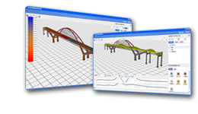
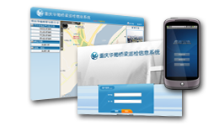
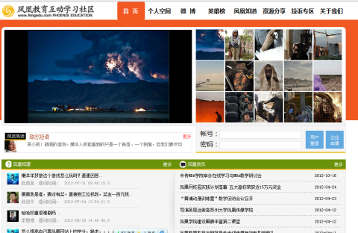
Solutions
Bridge Health Monitor System
Road & Bridge Mobile Inspection System
Enterprise Social Network Service Platform
5
of
11

Slide 6
Bridge Health Monitor System
Function
Bridge Inspection
Real sensor device data collection
Show bridge with 3D
Advantage
Cool Display: Best WPF 3D Engine
Big Data: 100,000,000+ Data
Multi-Device Support: 11+ Categories of Sensor Device
Customer
CaiYuanBa Long-River bridge
LiangJiang bridge
MaSangxi Long-River bridge
Engineering Service Platform
Mobile Application
Engineering model&Application
Sensor Data Collection
6
of
11

Slide 7
Road&Bridge Mobile Inspection System
Function
Submit inspection data by 3G/WiFi with mobile
Check person sign by GPS
Customer management report
Advantage
Multi-Device support: Android/IOS Pad/Mobile
Cloud Computing Deploy
Multi-Map support: Google/Baidu/Bing/ArcGIS map
Customer
Chongqing Fuling Bridge Management Department
Chongqing Huapu Bridge Management Company
Chongqing City Highway Bureau
Mobile Application
Engineering model&Application
Sensor Data Collection
7
of
11

Slide 8
Enterprise Social Network Service Platform
Function
Submit inspection data by 3G/WiFi with mobile
Check person sign by GPS
Customer management report
Advantage
Easy to easy work as Twitter/Weibo
Customize work flow&process
Multi-Target support: Web/Desktop/Mobile
Customer
Phoenix Education, Beijing
Lockwood Systems lnc
Western Chongqing Logistics Park
Mobile Application
Engineering model&Application
Sensor Data Collection
8
of
11

Slide 9
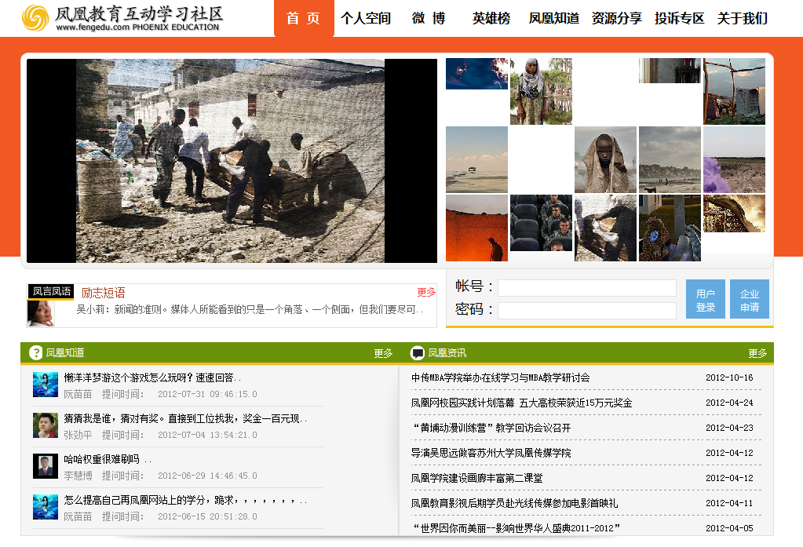
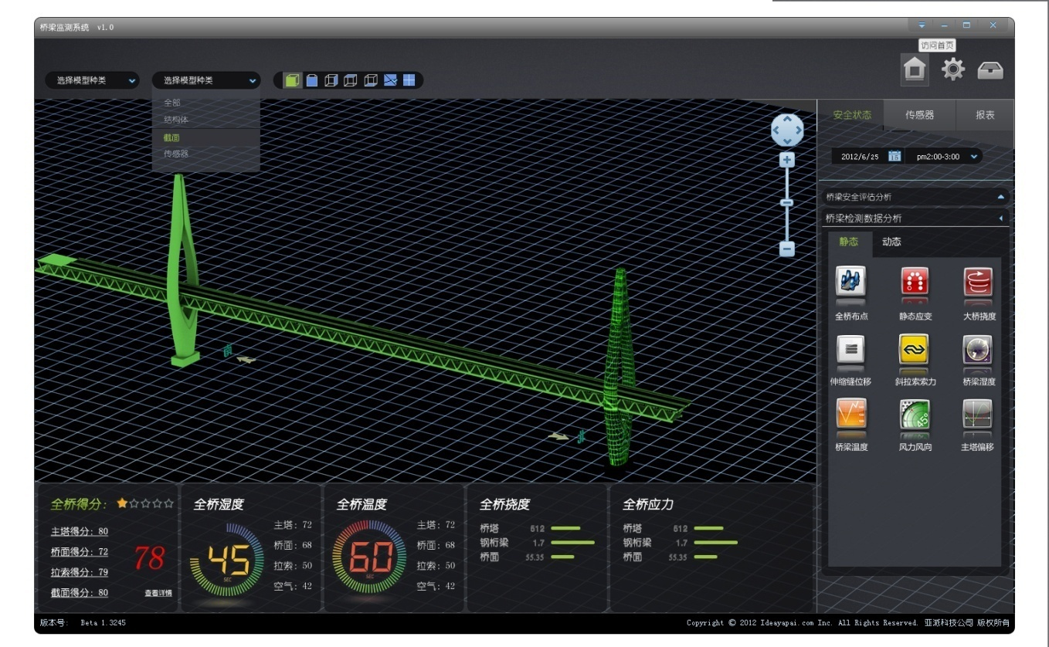
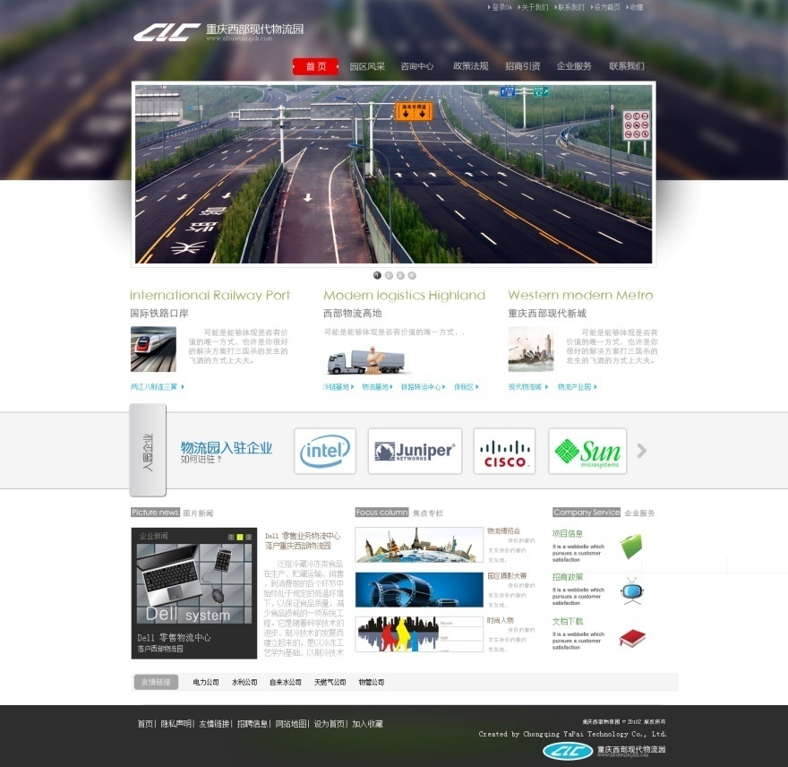
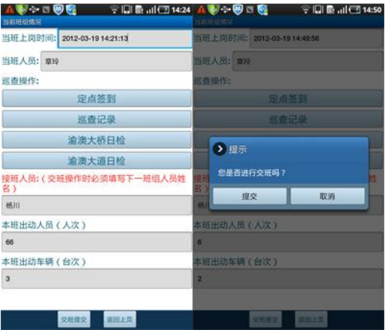
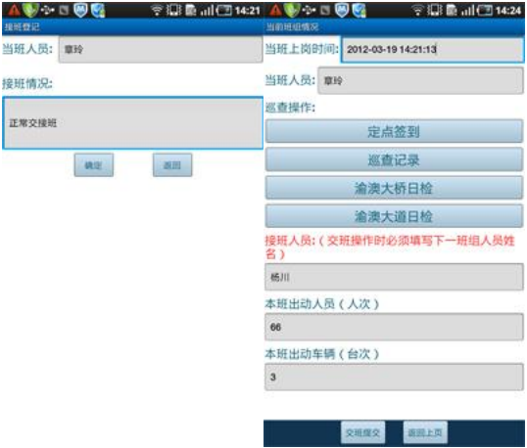
Projects
Bridge Health Monitoring System
Chongqing Western Logistics Park
Phoenix Education
Road&Bridge hand-held patrol system
9
of
11

Slide 10
Customer
Company
Chongqing City Construction Investment Corporation
Phoenix new United ( Beijing) Co.,Ltd
Lockwood Systems .lnc
Chongqing HuaPu Bridge Management Company
Government
The Western Logistics Park
Chongqing City Highway Bureau
Chongqing city Fuling District Road and Bridge Management Office
Chongqing city Banan District Highway Maintenance Section
10
of
11

Slide 11
THANK YOU!
Ideayapai

